Slide 1

Anti Patterns and Refactoring
Pengembangan Sistem Berorientasi Objek
Auzi Asfarian
Departemen Ilmu Komputer, FMIPA
Institut Pertanian Bogor

Slide 2

Most Software Projects Fail
According to new research, success in 68% of technology projects is "improbable." Poor requirements analysis causes many of these failures, meaning projects are doomed right from the start (ZDnet)

Slide 3
Some Pattern Related Concepts
Pattern: good ideas
AntiPatterns: bad ideas
Refactoring: better ideas

Slide 4



Anti Pattern
“recurring problem that is usually ineffective and risks being highly counterproductive”
Software Development
Software Architecture
Project Management

Slide 5
Software Development Anti Patterns
The Blob
Continuous Obsolescene
Lafa Flow
Poltergeist
Golden Hammer
Dead End
Spaghetti Code
Cut-and-Paste Programming
a lot more…

Slide 6

The Blob
"This is the class that is really the heart of our architecture."
AntiPattern Name: The Blob
Also Known As: Winnebago and The God Class
Most Frequent Scale: Application
Refactored Solution Name: Refactoring of Responsibilities
Refactored Solution Type: Software
Root Causes: Sloth, Haste
Unbalanced Forces: Management of Functionality, Performance, Complexity

Slide 7
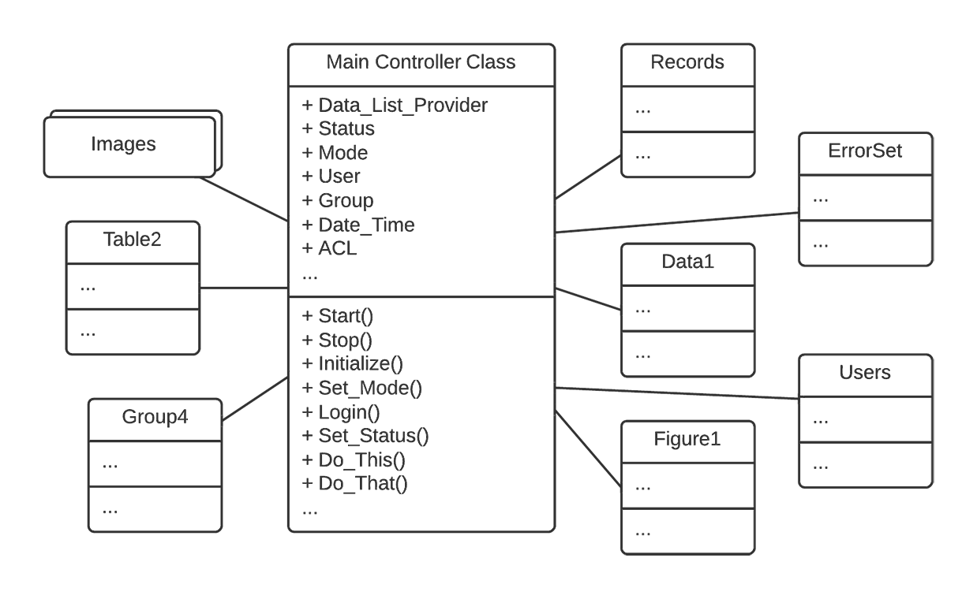
The Blob: Bentuk Umum
Objek blob memiliki sebagian besar proses sehingga objek lain hanya berfungsi sebagai menyimpan data

Slide 8
The Blob: Gejala dan Konsekuensi
Gejala:
Single class with a large number of attributes or operations.
A disparate collection of unrelated attributes and operations encapsulated in a single class.
A single controller class with associated simple, data-object classes.
An absence of object-oriented design.
A migrated legacy design that has not been properly refactored into an object-oriented architecture.
Dampak:
Compromises the inherent advantages of an object-oriented design.
Hard to modify.
Too complex for reuse and testing.
Expensive to load into memory, using excessive resources, even for simple operations.

Slide 9
Penyebab
Lack of an object-oriented architecture.
Lack of (any) architecture.
Lack of architecture enforcement.
Too limited intervention.
Specified disaster.
  If the requirements dictate a procedural solution, then architectural commitments may be made during requirements analysis that are difficult to change.

Slide 10
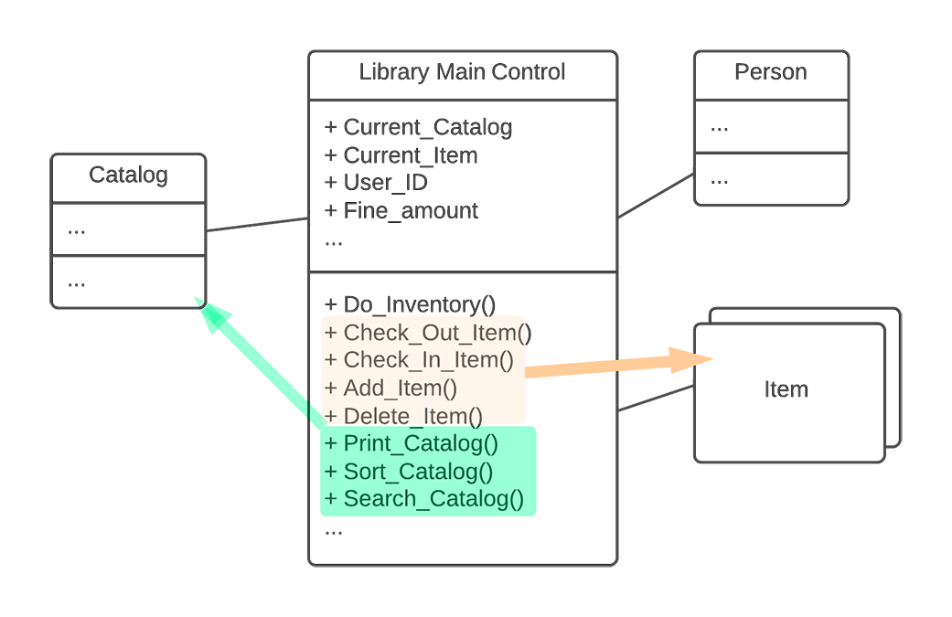
Refaktorisasi
Memindahkan fungsi-fungsi ke objek yang seharusnya

Slide 11

Continuous Obsolescene
Solution: open systems standards
“Technology is changing so rapidly that developers have trouble keeping up with the current versions of software and finding combinations of product releases that work together””

Slide 12
Lava Flow: A Story
"I don't know what that class is for; it was written before I got here."
"Oh that! Well Ray and Emil (they're no longer with the company) wrote that routine back when Jim (who left last month) was trying a workaround for Irene's input processing code (she's in another department now, too). I don't think it's used anywhere now, but I'm not really sure. Irene didn't really document it very clearly, so we figured we would just leave well enough alone for now. After all, the bloomin' thing works doesn't it?!"

Slide 13
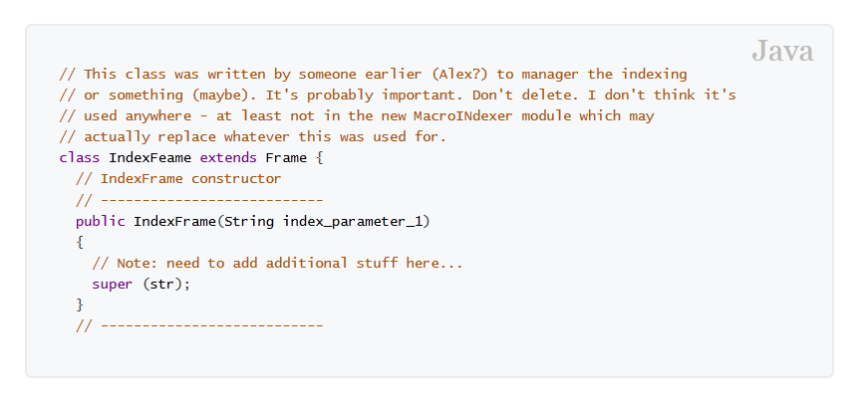
Lava Flow: Bentuk Umum

Slide 14
Lava Flow: Gejala dan Konsekuensi
Gejala:
Frequent unjustifiable variables and code fragments in the system.
Undocumented complex, important-looking functions, classes, or segments that don't clearly relate to the system architecture.
Very loose, "evolving" system architecture. Whole blocks of commented-out code with no explanation or documentation.
lots of "in flux" or "to be replaced" code areas.
Unused (dead) code, just left in.
Unused, inexplicable, or obsolete interfaces
Dampak:
proliferate as code is reused in other areas.
it rapidly becomes impossible to document the code or understand its architecture enough to make improvements.

Slide 15
Lava Flow: A Story
R&D code placed into production without thought toward configuration management.
Uncontrolled distribution of unfinished code.
Single-developer (lone wolf) written code.
Lack of configuration management or compliance with process management policies.
Lack of architecture, or non-architecture-driven development.
Repetitive development process.
the goals of the software project are unclear or change repeatedly.
Architectural scars.

Slide 16
Cut and Paste Programming: Gejala
The same software bug reoccurs throughout software despite many local fixes.
Lines of code increase without adding to overall productivity.
Code reviews and inspections are needlessly extended.
It becomes difficult to locate and fix all instances of a particular mistake.

Slide 17
Cut and Paste Programming: Dampak
Software defects are replicated through the system.
Reusable assets are not converted into an easily reusable and documented form.
Developers create multiple unique fixes for bugs with no method of resolving the variations into a standard fix.
Cut-and-Paste Programming form of reuse deceptively inflates the number of lines of code developed without the expected reduction in maintenance costs associated with other forms of reuse.

Slide 18
Cut and Paste Programming: Penyebab
It takes a great deal of effort to create reusable code.
The context or intent behind a software module is not preserved along with the code.
The organization does not advocate or reward reusable components
There is a lack of abstraction among developers.
The organization insists that code must be a perfect match to the new task to allow it to be reused.
Reusable components, once created, are not sufficiently documented or made readily available to developers.
A "not-invented-here" syndrome is in operation in the development environment.
There is a lack of forethought or forward thinking among the development teams.

Slide 19
Cut and Paste Programming: Penyebab
Cut-and-Paste AntiPattern is likely to occur when people are unfamiliar with new technology or tools; as a result, they take a working example and modify it, adapting it to their specific needs.

Slide 20
Project Management Anti Patterns
Death by Planning
Fear of Success
Irrational Management
Smoke and Mirrors
Throw It Over the Wall
Email is Dangerous
a lot more…

Slide 21
Death by Planning
In many organizational cultures, detailed planning is an assumed activity for any project. (better suited for manufacturing activities)
Death by Planning occurs when detailed plans for software projects are taken too seriously.
Many projects fail from over planning. Over planning often occurs as a result of cost tracking and staff utilization monitoring.

Slide 22
Death by Planning: Solution
Deliverables should be identified at two levels:
  Product(s) to a customer
  Components (within products).
The deliverable plans should be updated weekly to ensure appropriate planning and controls that reduce project risks.
When estimating it is advisable to allow a contingency period for all those inevitable "unknowns," such as:
  Requirements increase (creep).
  Design dead ends.
  Third-party software workarounds.
  Defect identification (finding the problem in a set of integrated components).
  Defect correction (bug fixing).

Slide 23
Fear of Success
An interesting phenomenon often occurs when people and projects are on the brink of success.
Some people begin to worry obsessively about the kinds of things that can go wrong.
Solution: Management must declare that the project success

Slide 24
Irrational Management
The manager lacks the ability to manage:
Development staff.
Other managers.
Development processes.
He or she also has no clear vision and strategy, and therefore:
Cannot make decisions.
Fear of Success
Is ignorant of the true state of project activities and deliverables.

Slide 25
Irrational Management: Solusi
Admit you have a problem and get help.
Understand the development staff.
Provide clear, short-term goals.
Share a focus.
Look for process improvement.
Facilitate communication.
Manage communication mechanisms
Manage by exception.
Apply effective decision-making techniques.

Slide 26
Smoke and Mirrors
Demonstration systems are important sales tools, as they are often interpreted by end users as representional of production-quality capabilities.
The end user is led to believe that capabilities can be delivered when in fact they cannot, at least not within the predetermined functionality, budget, and schedule.
When the development project fails to deliver, the project is considered unsuccessful, and the development organization loses credibility.
Solution: Managing Expectation
  A typical rule of software engineering is that a deliverable system costs three times as much as an engineering prototype. A set of reusable software costs up to three times as much as software for a deliverable system.
  Another rule, supported by survey evidence, is that any software development will take about twice as long and cost twice as much as expected.

Slide 27
Throw it Over the Wall
Object-oriented methods, design patterns, and implementation plans intended as flexible guidelines are too often taken literally by downstream managers and OO developers.
Such literal interpretation of flexible guidelines can lead to unintended results.
Effort may be wasted on useless analyses and documentation because it appears mandated, although nobody on the development team understands its purpose.
Solution: deliver the knowledge through appropriate method

Slide 28
Email is Dangerous
E-mail is an important communication medium for software developers.
It is an inappropriate medium for many topics and sensitive communications.
For example, e-mail is inappropriate for most confrontational discussions.
Productivity and morale of a software project can quickly degenerate when other staff members get caught up in lengthy e-mail confrontations.
E-mail is an inefficient mode of communication for complex topics.

Slide 29
Email is Dangerous
Treat every e-mail as if it were going directly to your worst enemies and toughest competitors.
  A "confidential" message is likely to end up in the inbox of the person you least want to read it.
Treat every e-mail as if it will be printed on the front page of The Washington Post.
  E-mail can be distributed to large numbers of people instantaneously.
Treat every e-mail as if it could be used as evidence in a court of law.

Slide 30
Software Architecture Anti Patterns
Vendor Lock-In
Reinvent the Wheel
Swiss Army Knife
The Grand Old Duke of York
Warm Bodies
Wolf Ticket
And my more…

Slide 31
Vendor Lock-In
Vendor Lock-In occurs in systems that are highly dependent upon proprietary architectures. The use of architectural isolation layers can provide independence from vendor-specific solutions.

Slide 32

Reinvent the Wheel
The pervasive lack of technology transfer between software projects leads to substantial reinvention. Design knowledge buried in legacy assets can be leveraged to reduce time-to-market, cost, and risk.

Slide 33
Swiss Army Knife
A Swiss Army Knife is an excessively complex class interface. The designer attempts to provide for all possible uses of the class. In the attempt, he or she adds a large number of interface signatures in a futile attempt to meet all possible needs.

Slide 34

Bahan Referensi
AntiPatterns: The Survival Guide
http://sourcemaking.com/antipatterns-book

